Slide 1
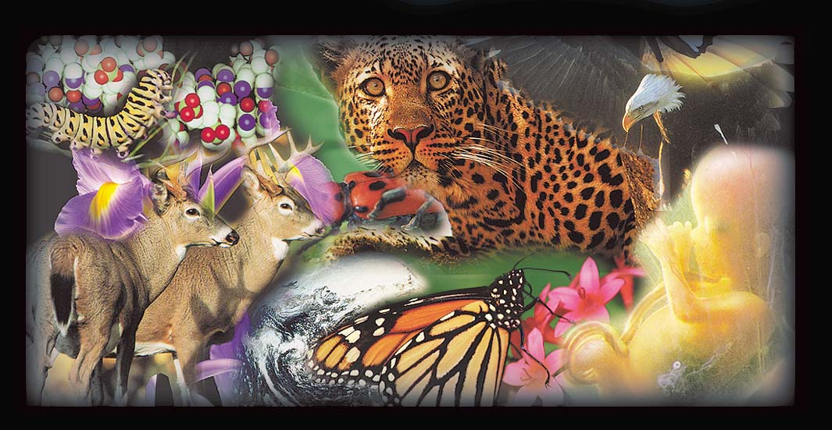
創造的明證舉隅
羽智雲
yusufyu@yahoo.com.hk
2013‧09‧21
資料來源：http://www.harunyahya.com

Slide 2
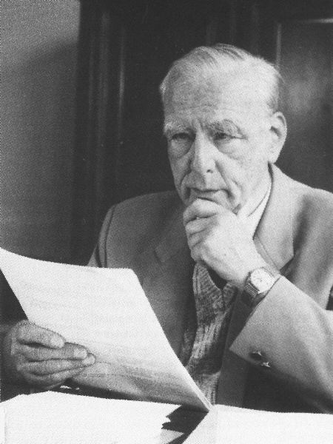
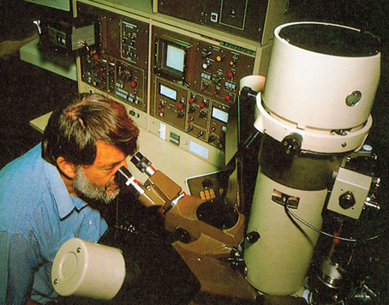
發明了電子顯微鏡 (1931)
(1906 1988)
恩斯特·魯斯卡Ernst Ruska
Notes:
Ernst August Friedrich Ruska (1906–1988) was a German physicist who won the Nobel Prize in Physics in 1986 for his work in electron optics, including the design of the first electron microscope.

Slide 3

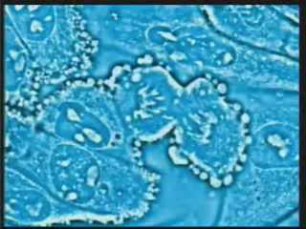

Slide 4

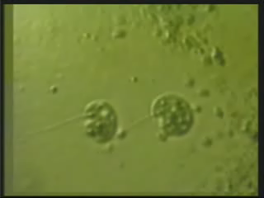

Slide 5

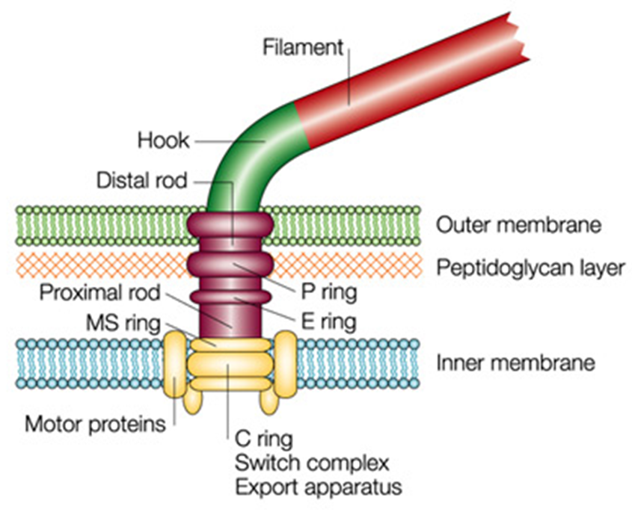
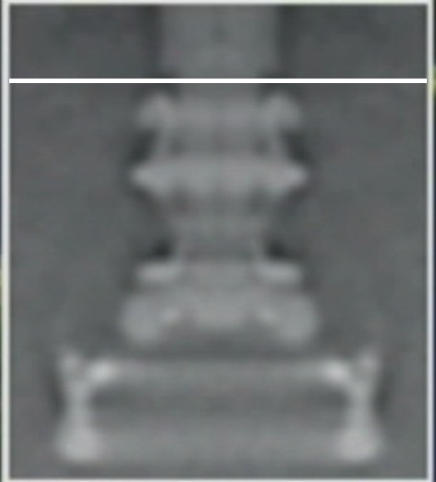
Liquid Environment
鉤 (Hook)
Flagellin

Slide 6

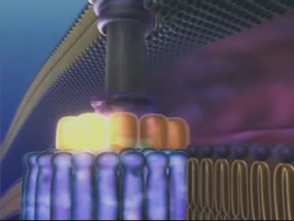

Slide 7
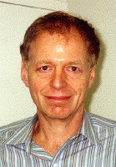
詹姆斯·夏皮羅
James Shapiro
"達爾文論者對基本的生化或細胞系統的演化，全無半點解釋，只有多種一廂情願的猜測。"
(James Shapiro, In the details . . . what? National Review, 62-65. 9-16-1996. )
Notes:
James A. Shapiro is an American biologist, an expert in bacterial genetics and a professor in the Department of Biochemistry and Molecular Biology at the University of Chicago.

Slide 8

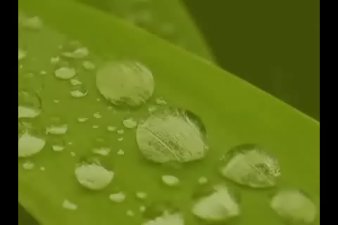

Slide 9

真主的確不嫌以蚊子或更小的事物設任何譬喻；信道者都知道那是從他們的主降示的真理；不信道者卻說：「真主設這個譬喻的宗旨是甚麼？」…
(古蘭 2:26)

Slide 10
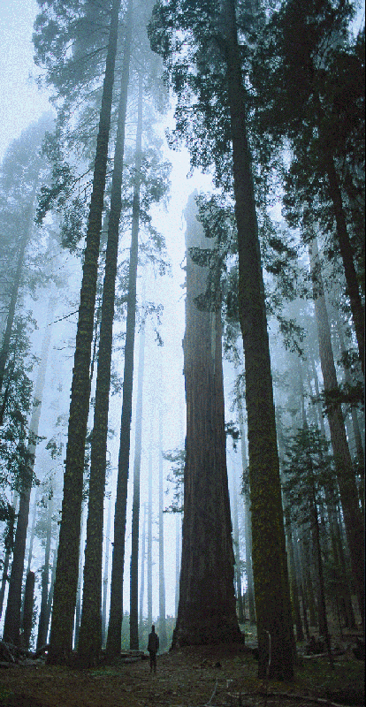


Slide 11
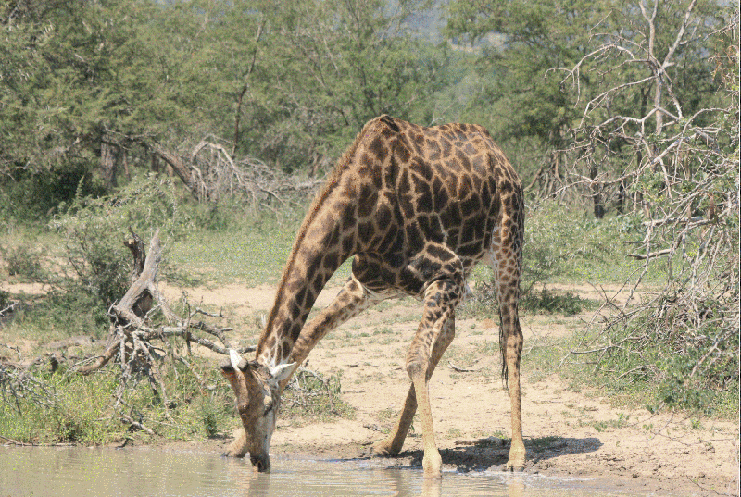
長頸鹿每次低下頭喝水時本應早就因高血壓而暴斃。但牠頸的巧妙設計使牠脫險，當牠低下頭時，頸部血管的活門便會自動關上，阻止過量的血液流向大腦。

Slide 12
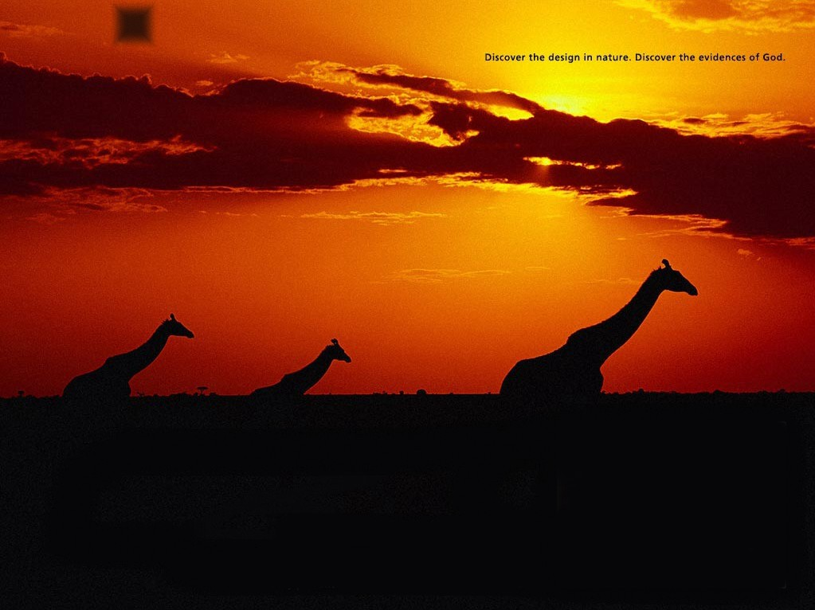
探究天然的設計，可認識真主創造的明證。

Slide 13
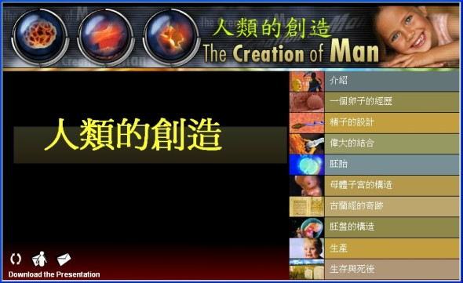

Slide 14
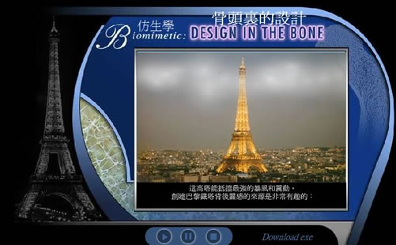

Slide 15
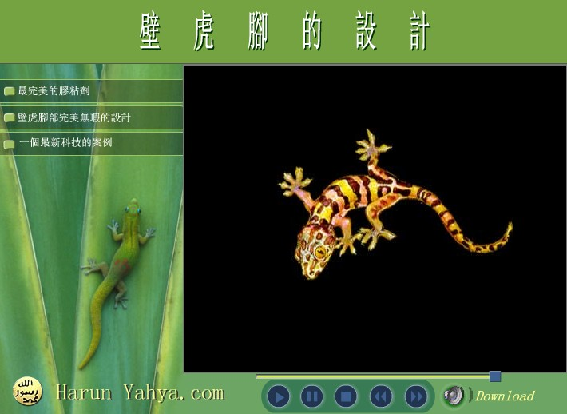

Slide 16
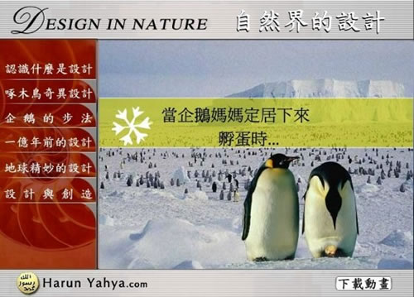

Slide 17
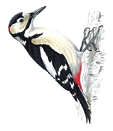

Woodpeckers 啄木鳥
uniquely resilient tail feathers 尾毛富彈力
2 toes in front & 2 toes in back兩趾向前、兩趾向後
tail feathers and feet form tripod兩脚及尾巴成鼎狀
Notes:
http://www.straight-talk.net/evolution/woodpecker.htm

Slide 18
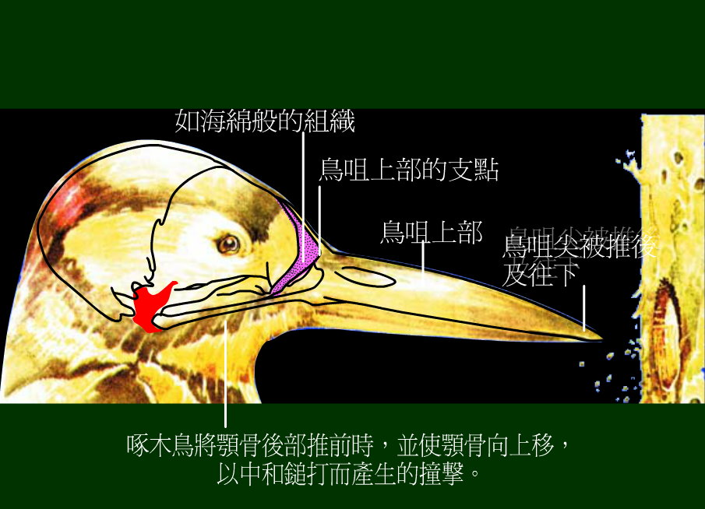

Slide 19
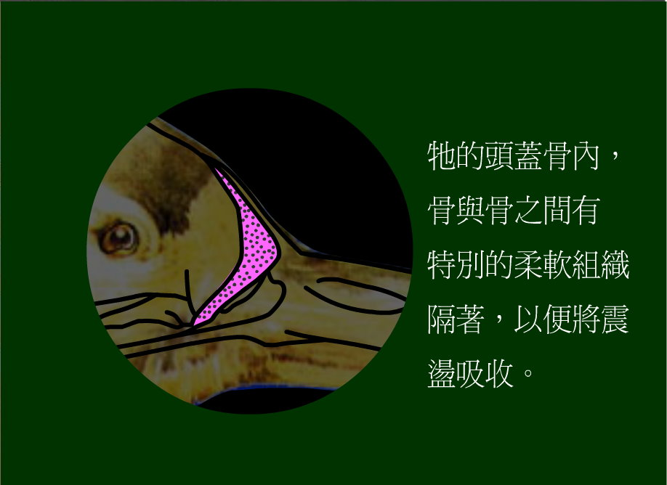

Slide 20
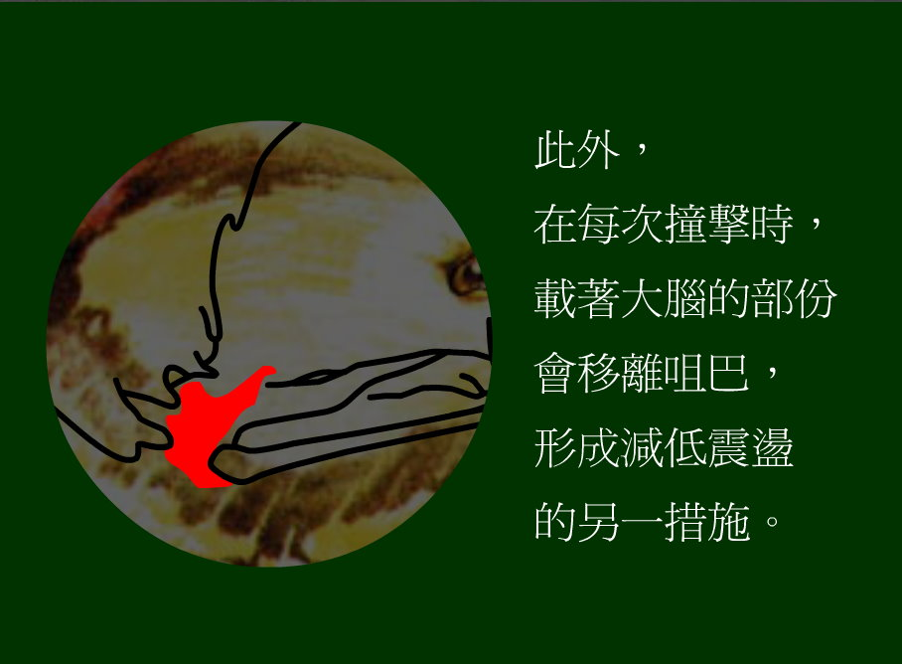

Slide 21
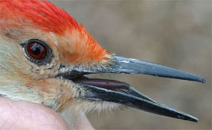
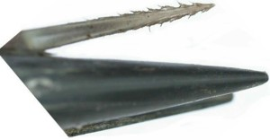
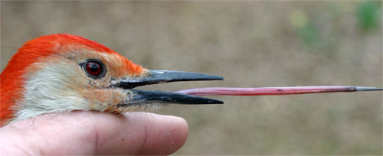

Slide 22
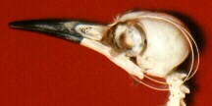
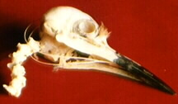

Slide 23
